Slide 1
Computer Vision Project
Rahul Velamala
SC21B127

Slide 2
Objective:
Using GAN for fake digit and anime face generation.
Using CGAN for generation of specific digit generation.
Datasets Used:
MNIST(Modified National Institute Of Standards and Technology) for digits which contains handwritten digits from 0 to 9.
Anime Face Dataset from Kaggle.

Slide 3
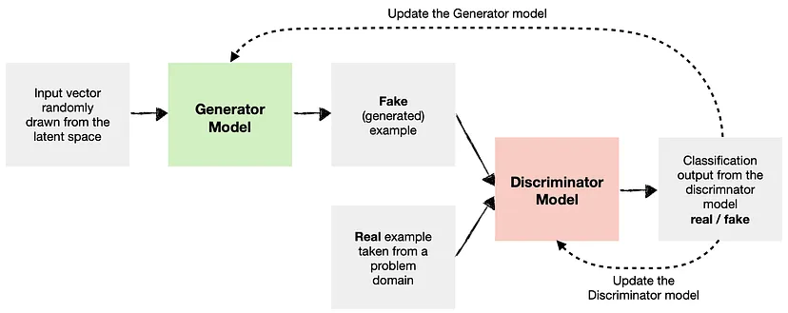
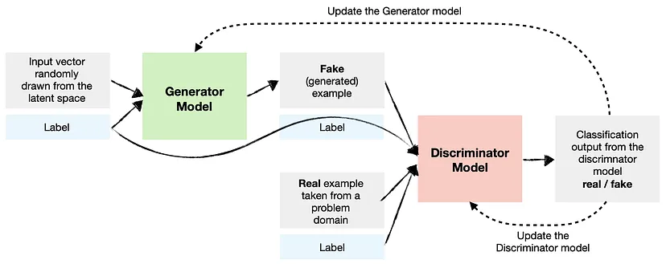
Overview Of GANs and CGANs
Normal GAN
Conditional GAN

Slide 4
Discriminator Network:
We were taking an input image and giving the output as a value between 0 and 1.
We use Leaky Relu as the nonlinearity.
And at the end we use the sigmoid to get the probability.

Slide 5
Generator Network:
Here we will take a random tensor and convert it into a image.
We will use transpose convolution to make the random tensor to an image.
We use hyperbolic tangent function to normalize the values to range(-1,1) as we have normalize them in the start.

Slide 6
Discriminator Training
As we Know that the job of the discriminator is to just tell its real or fake it’s a classification problem.
So we use Cross Entropy loss function.
We expect the discriminator to output 1 if the image was picked from the real dataset and 0 if it was generated using generator network.
We first pass a batch of real images, and compute the loss, setting the target labels to 1.
Then we pass a batch of fake images (generated using the generator) pass them into the discriminator, and compute the loss, setting the target labels to 0.
Finally we add both of the losses and perform gradient descent on this.

Slide 7
Generator Training:
We generate a batch of images using the generator, pass the into the discriminator.
We calculate the loss by setting the target labels to 1 i.e. real. We do this because the generator's objective is to "fool" the discriminator.
We use the loss to perform gradient descent i.e. change the weights of the generator, so it gets better at generating real-like images to "fool" the discriminator.

Slide 8
Evaluation Metrices
We can evaluate the model using real score, fake score and the generator loss , discriminator loss.
We want the generator loss to be as less as possible while the discriminator loss shouldn’t go high.
And the real score should be near to 1 and fake score should be near to 0.

Slide 9
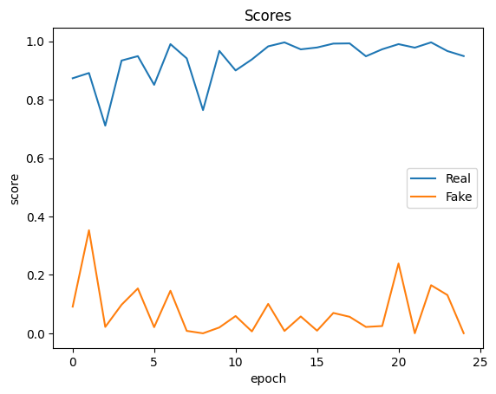
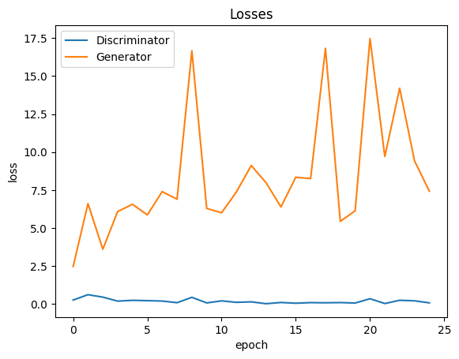
Evaluation Metrics for anime face dataset:

Slide 10
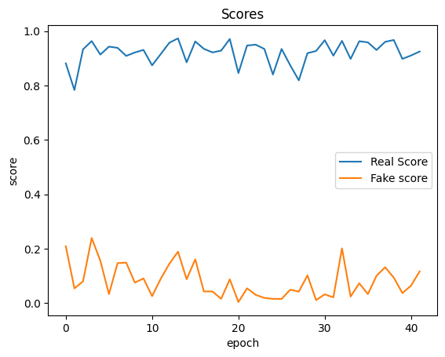
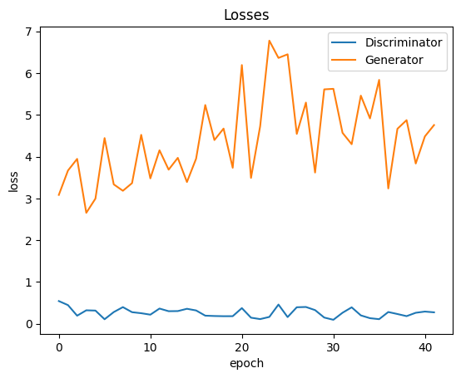
Evaluation Metrices for MNIST dataset

Slide 11
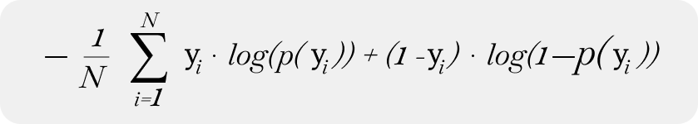
For the conditional GAN the yi will be conditioned with the labels it’s the change in the loss function.

Slide 12
Why did I choose 2 datasets :
While implementing conditional GAN I cannot give specific features .Like I can tell it to generate a specific number but if I use anime face dataset I cannot tell it generate a specific type of image as labels were not available.
I used fully connected layers for MNIST .But I used Convolution Layers for the anime dataset.
I didn’t use the convolution layer for the CGAN because its taking more time to train.

Slide 13
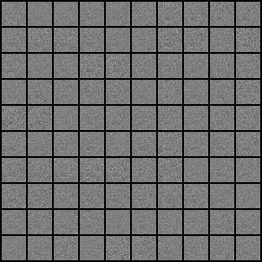
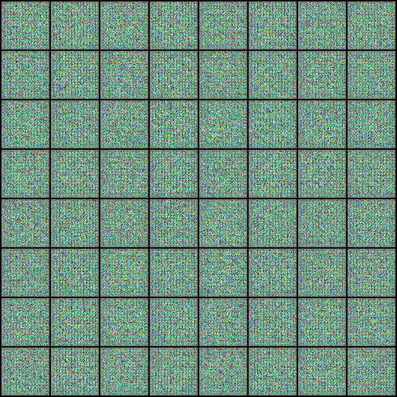
Results

Slide 14


The changes I had made for making CGAN
At every step concatenate the labels along with the random noise.
The labels will act as the embeddings.
This 6 and 8 was generated using the conditional GAN.

Slide 15
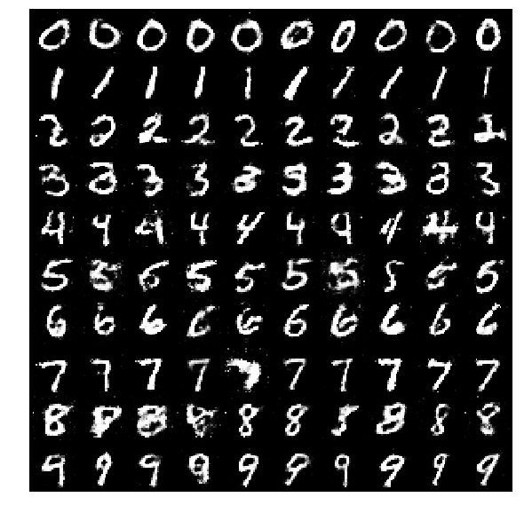

Slide 16
Thank you

